Slide 1
Requirements prioritisation
IMT2019525 VIJAY JAISANKAR

Slide 2
Lime

Slide 3
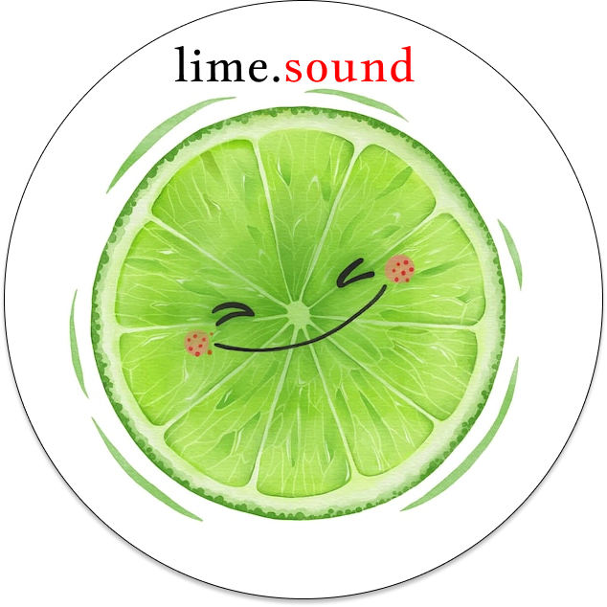
Lime: An end-to-end music creation, hosting, and promotion platform for budding creators.

Slide 4
Mission statement: Harness the power of communities and make your sounds heard.
Vision statement: To be the top preferred music platform for any new creator, anywhere.

Slide 5
Requirements prioritisation

Slide 6
Source
https://www.businessanalystlearnings.com/blog/2016/8/18/a-list-of-requirements-prioritization-techniques-you-should-know-about

Slide 7
Ranking
This method can be useful in limited contexts after Lime has matured in the market
Users can vote on the new feature they like the most, and that can be taken up by the development team
However, as this method only works for one stakeholder and as the product is early-stage, we won’t be using this method.
In this method, we give each requirement a different numerical value based on its importance.

Slide 8
Grouping
This method seems more promising than ranking, as the discretisation leads to less confusing classification between requirements
However, creating the mental map or a scoring metric for the priorities will be a hassle and communicating the same adds to the complexity.
Hence, although this method is better than Ranking, we can do better for Lime.
In this method, requirements are grouped into critical, moderate, and optional priorities.

Slide 9
MoScoW
MUST (Mandatory)
SHOULD (Of high priority)
COULD (Preferred but not necessary)
WOULD (Can be postponed and suggested for future execution)
Instead of numbers, here, requirements are grouped as follows:

Slide 10
Why MoScoW is the best technique for Lime
This is the most intuitive method for the most important stakeholders to vote on - as there is no numerical thresholding to rely on, and the notions of MoScoW are natural to all people in the business.
Getting the inputs for the same are also easy - through community meetings and forms for the artists and users alike.
Some parts of the MoScoW are directly transferable from the licenses and SLAs.
All of the outputs of this technique will directly contribute to timely and organised building of Lime and can be implementable in an Agile development lifecycle.
Hence, of the requirement prioritisation methods we’ve seen, MoScoW is the most optimal, and hence, we will use this method for Lime.

Slide 11
Methodology
How Lime implements the MoScoW technique

Slide 12
Requirements Gathering
The MUST requirements directly follow from the Lean canvas and value canvas, and the market research
We can then gather SHOULD and COULD requirements directly from the site and on Github discussions
We will also hold frequent community meet-ups, which can serve as a faucet for COULD and WOULD requirements, social media, online communities, and Github issues will also contribute to these.
From different stakeholders

Slide 13
Using the requirements effectively
We can use Github releases and create separate labels for each schema of the MoScoW framework.
We can also track these requirements and create sprint plans using Github project boards
We can then manage mappings between releases and requirements in a transparent manner and handle scope changes effectively, by keeping discussions and meetings.
Incremental development of the product

Slide 14
Thank you!
IMT2019525 Vijay Jaisankar

